Slide 1
These are the original ivyscript csv functions
2017-04-11
These functions still work, and if you are repeatedly retrieving different values from the same csv file, they will run a bit faster.
But they are now deprecated (meaning it is suggested not to use them any more) since the newer builtin csv functions now exactly mirror the ivy companion standalone command line csv utilities, and are easier to understand.

Slide 2
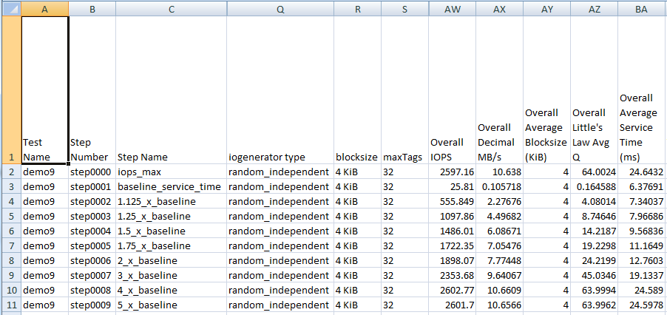
Accessing csv files – row and column
Test step csv files (not shown) have one line per subinterval
(both host & subsystem data) Summary csv files like this one have one line per test step.
Header row is row -1
Row 0 is test step 0 or subinterval 0
Use column number from 0, or say "Overall IOPS"

Slide 3
Csv file builtin functions 1/3
set_csvfile(string filename);
Loads csv file into a kind of spreadsheet object, if it's not already loaded into memory.
You can load multiple csv files and switch back and forth.
All subsequent csvfile calls refer to the currently set csvfile.
drop_csvfile(string filename);
If you are done with it and you would like to release the space.
int csvfile_rows();
Number of rows following the header row.
Returns -1 if invalid file or file empty. Returns 0 if there was only a header row.
int csvfile_columns_in_row(int row); int csvfile_header_columns(); same as csvfile_columns_in_row(-1)

Slide 4
Csv file builtin functions 2/3 – individual cells
string csvfile_cell_value(int row, int column); string csvfile_cell_value(int row, string column_header_text);
You can refer to a column using an int, the column index from zero.
You can refer to a column using a string, the column header text.
string csvfile_raw_cell_value(int row, int column); string csvfile_raw_cell_value(int row, string column_header_text);
ivy "wraps" text fields as a formula with a string constant, e.g. ="horse"
This stops Excel from interpreting 1-1 as January 1st, and 00:00 from interpreting as a time.
The csv file functions normally "unwrap" csv column values, removing this kind of wrapper or removing simple double quotes surrounding a value, to treat ="horse", "horse" and horse the same
Retrieving the raw value give you exactly what was between the commas in the csv file.

Slide 5
Csv file builtin functions 3/3 – headers & slices
string csvfile_column_header(int col);
Give you the text of the column header
string csvfile_column(int col); string csvfile_column(string column_header);
Gives you a "column slice" of the spreadsheet showing "raw" values.
E.g. "IOPS,55,66,55,44"
Demo number 8 shows iterating through the column slices to write out the transpose of a csv file.
string csvfile_row(int row);
Gives you a "row slice" of the spreadsheet showing the "raw" values.
E.g. ="random_independent",="4 KiB",32,2601.7

